Slide 1
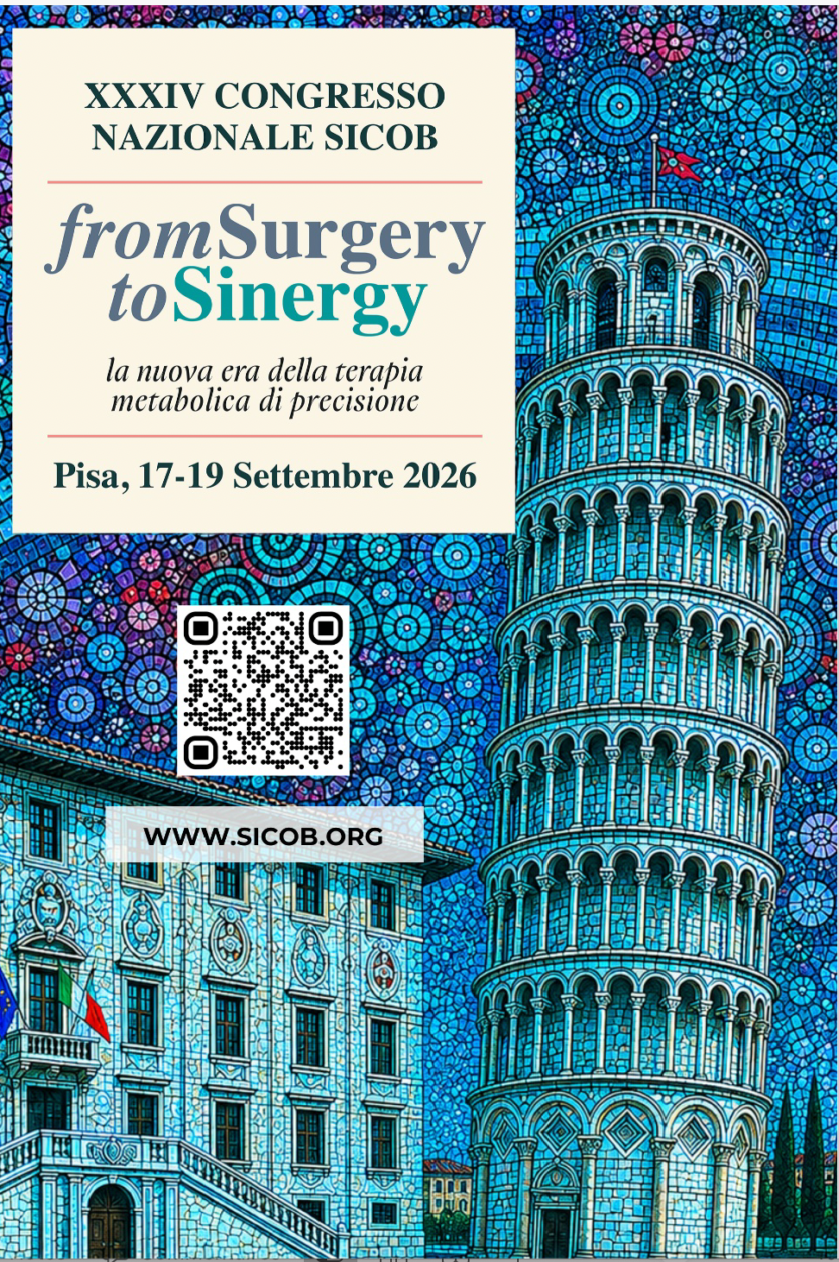
Transit Bipartition vs
RYGBP :
French RCT : BIPASS Study
Prof. Robert Caiazzo, MD, PhD
CHU de Lille
Endocrine Surgery, Hepatology, Pathology, and Nutrition, CHU Lille
UMR Inserm 1190 Translational Research in Diabetes, Lille University
Labex EGID (European Genomic Institute for Diabetes)
ESA Board member, SOFFCO board member

Slide 2
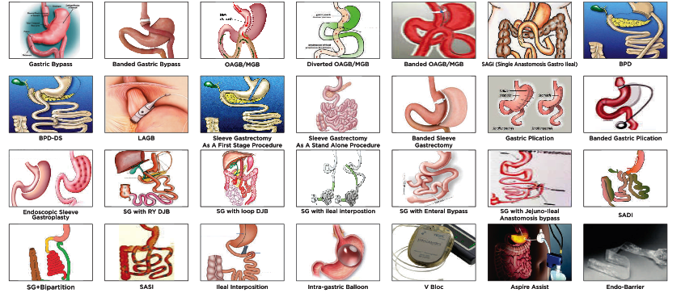
Background

Slide 3
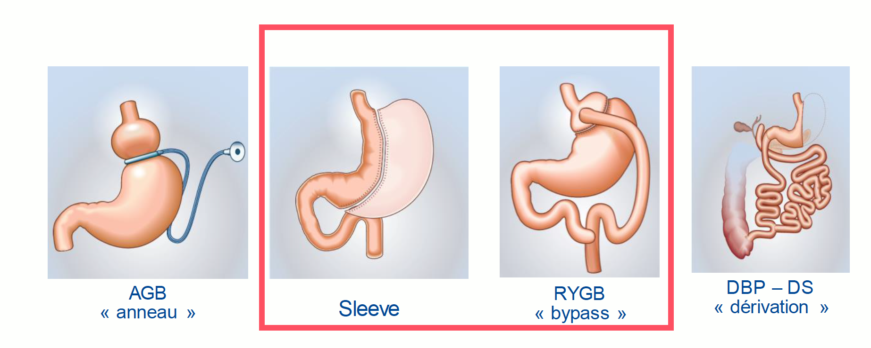
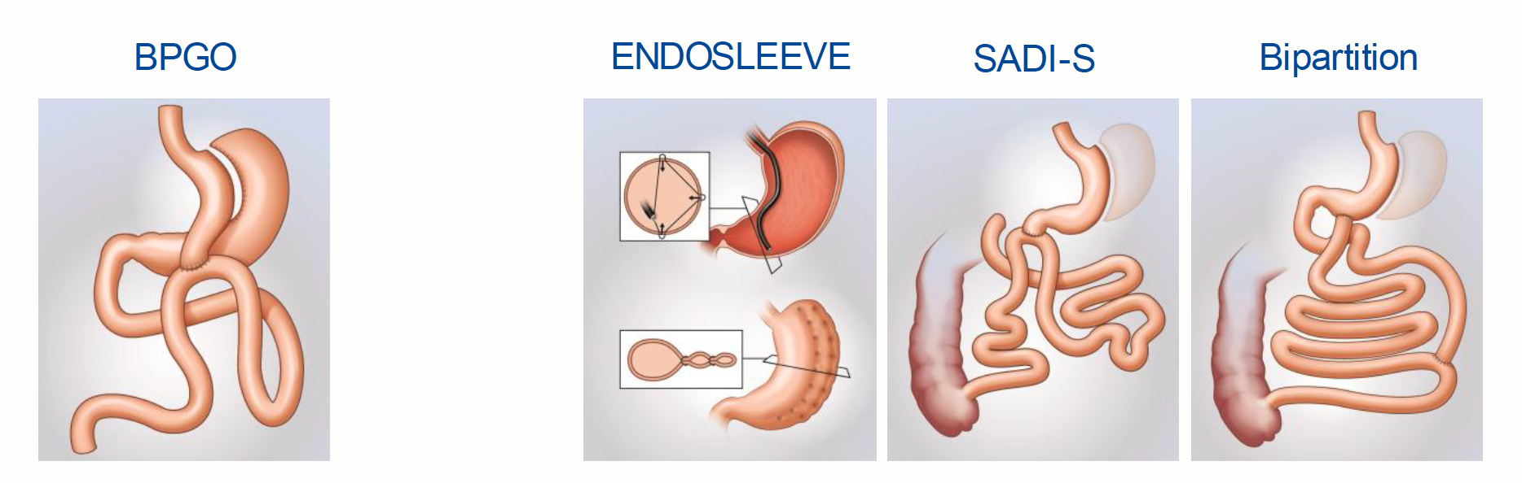
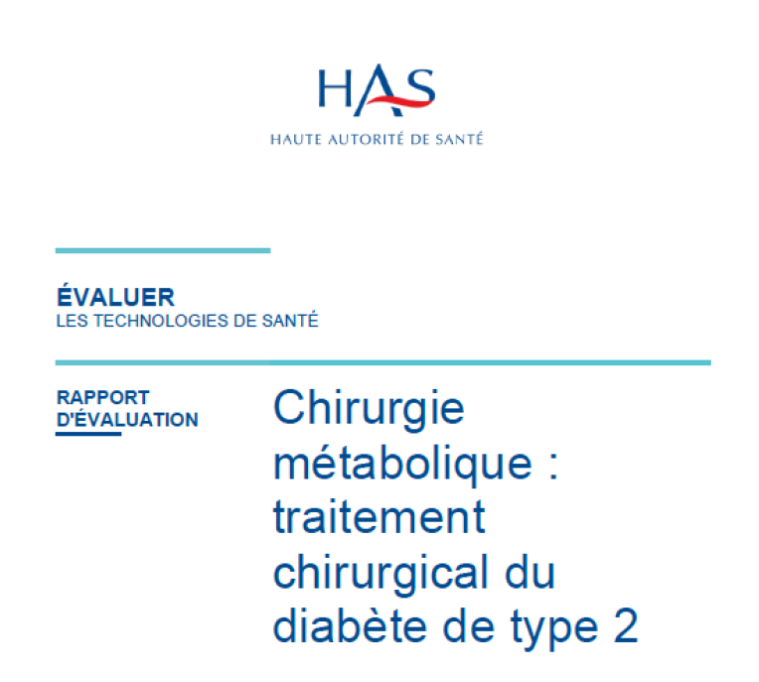
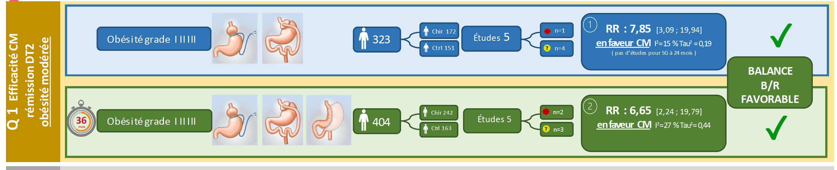
Background
DM2 + BMI > 30 kg/m2

Slide 4
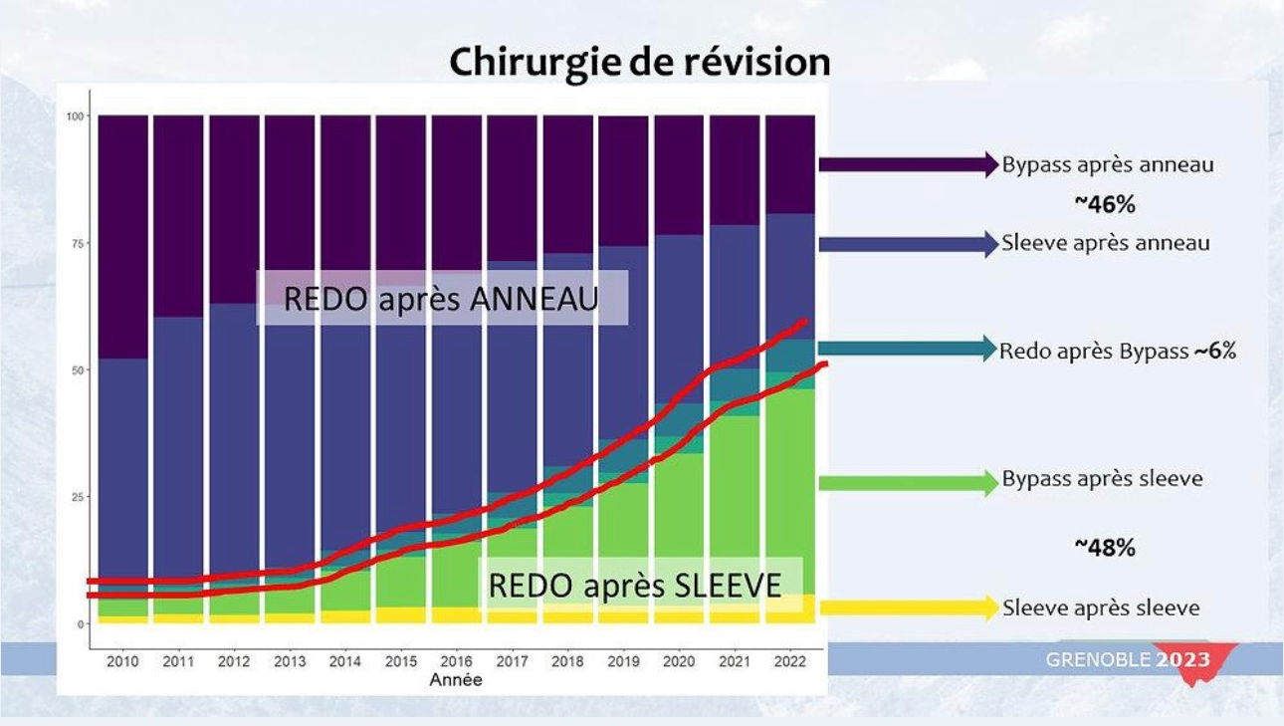
Background
Sleeve gastrectomy
More than 60% of the procedures performed in France.
Maximal weight loss at one year, then weight regain and relapse of comorbidities, particularly above a BMI of 50 kg/m².
Lazzati, A

Slide 5
Background
Sleeve gastrectomy
Roux-en-Y gastric bypass
More than 60% of the procedures performed in France.
Maximal weight loss at one year, then weight regain and relapse of comorbidities, particularly above a BMI of 50 kg/m².
The reference procedure: sustained weight loss, marked metabolic effect, feasible after most operations and in the presence of reflux.
After a failed sleeve, complementary excess weight loss of only 23%, against 59% after duodenal switch.

Slide 6
Background
Sleeve gastrectomy
Roux-en-Y gastric bypass
Duodenal switch and SADI-S
More than 60% of the procedures performed in France.
Maximal weight loss at one year, then weight regain and relapse of comorbidities, particularly above a BMI of 50 kg/m².
The reference procedure: sustained weight loss, marked metabolic effect, feasible after most operations and in the presence of reflux.
After a failed sleeve, complementary excess weight loss of only 23%, against 59% after duodenal switch.
The most effective procedures, with 83% excess weight loss at two years.
Higher complication rates, increased mortality risk, and a lifelong risk of protein and micronutrient deficiency that is difficult to correct.
29.6%
of patients operated on in France were still attending medical or surgical follow-up five years after surgery, although follow-up is fully reimbursed. Any further escalation of malabsorption would therefore take place in a population largely lost to nutritional surveillance.

Slide 7

Background
YOMEGA Trial,
Maud Robert, Lancet
SADISLEEVE Trial,
Maud Robert, Lancet
BIPASS Trial,
Robert Caiazzo,
in preparation

Slide 8
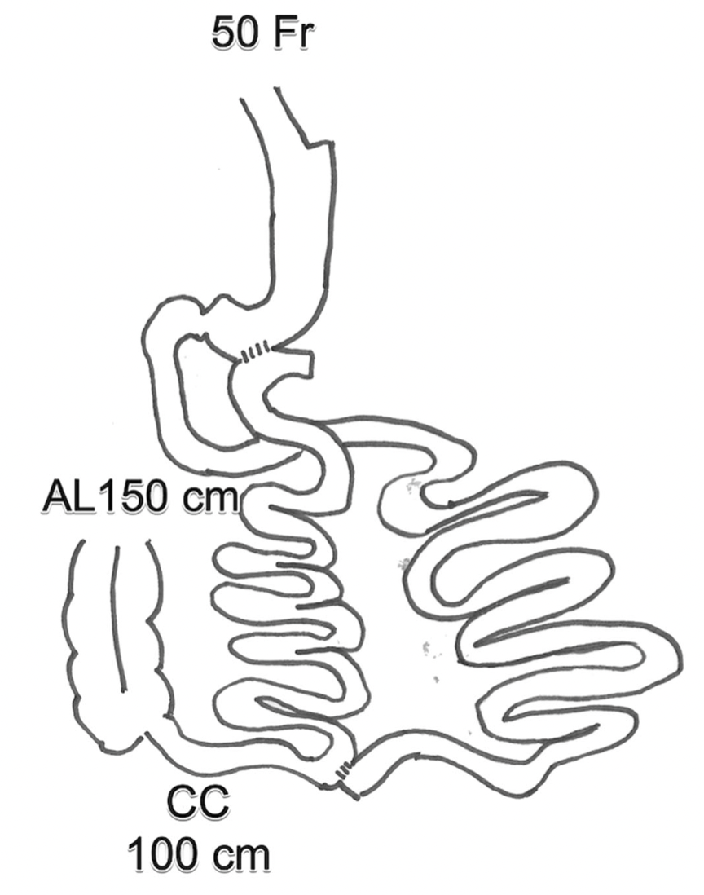
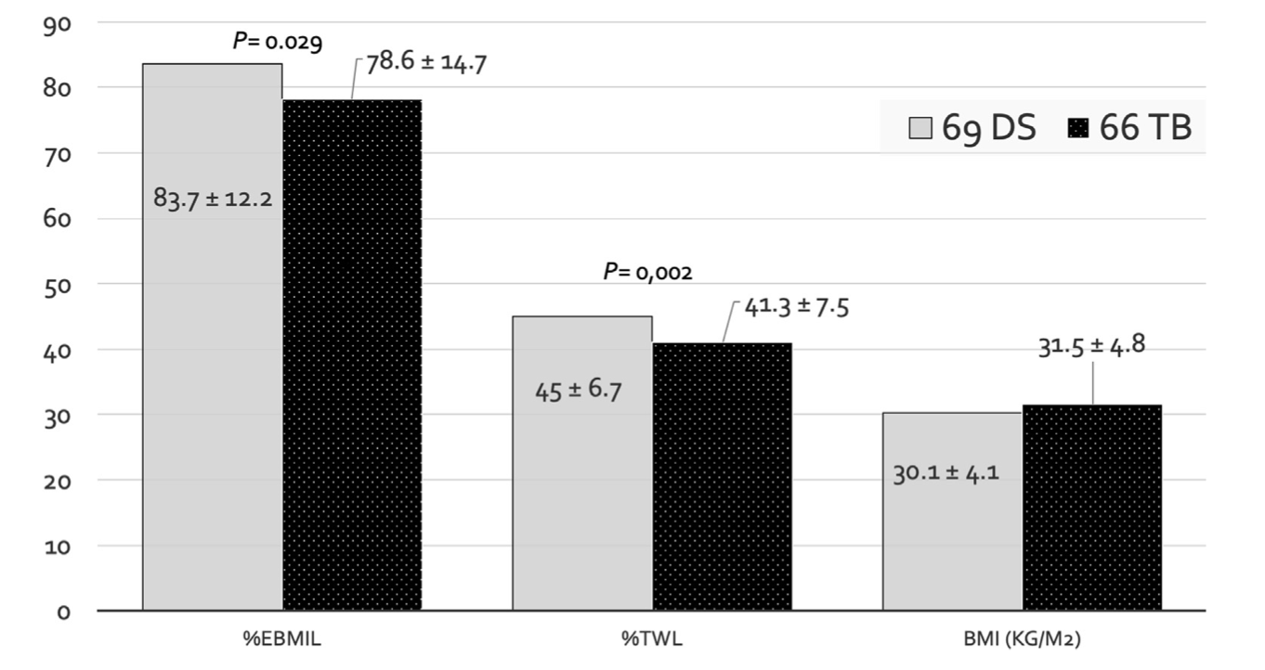
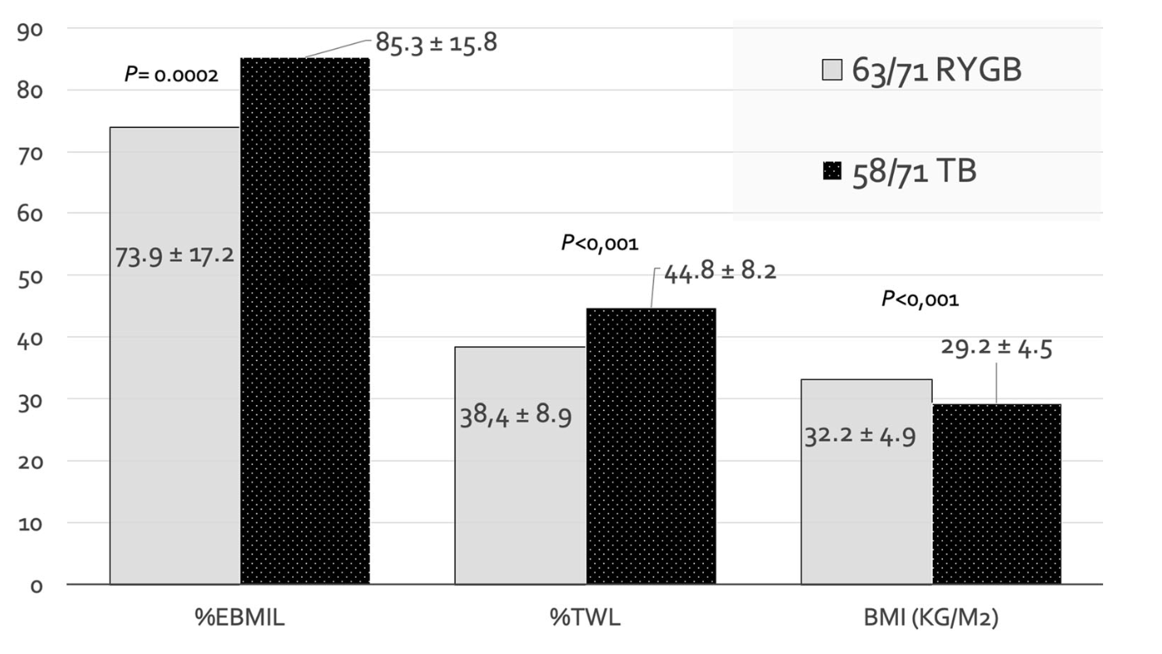
Background
Weight loss TB vs RYGBP
Weight loss TB vs DS
91% EWL at 1 year
78.6 % ± 14.7
Santoro S et al., Ann Surg 2012
83.7 % ± 12.2
IMC>50 kg/m²
Diarrhea: 7% / TB vs 33% / DS p=0.16
Topart P et al., Obes Surg, 2020
Topart P et al., SOARD, 2020
Notes:
Topart suivi 2 ans, super obèse
SG+TB has been initially designed for metabolic surgery in non-obese patients and is now used for obese
patients, super obese or after SG failure (insufficient weight loss or weight regain). Thousands of patients have
been operated on all over the world, and in France, with satisfactory results. Topart et al. report 78.6±14.7 %
of excess weight loss at one year and significantly fewer stools per day than BPD-DS25
.

Slide 9
Background
Largest cohorts and longest follow-up
Study | Population, technique | n | Follow-up (% seen) | Key findings
Santoro, Ann Surg 2012 | SG+TB, BMI 33 to 72 | 1020 | 5 years (59 %) | EBMIL ~74 % at 5 years
Al, Surg Endosc 2022 | SG+TB, mean BMI 34 | 883 | 1 year | Early safety and efficacy
Al, Obes Facts 2022 | SG+TB, T2D, BMI 34 | 355 | 2 years (89 %) | TWL 20.2 %; EBMIL 87.7 %
Ribeiro, Obes Surg 2024 | OATB (single loop) | 68 | 5 years | Hypoproteinaemia 5.9 %
Non-randomised comparisons with Roux-en-Y gastric bypass
Study | Comparison | n | Follow-up | Key findings
Topart, Obes Surg 2020 | TB vs RYGB, BMI ≥ 50 | 71 + 71 | 2 years | EBMIL 85.3 vs 73.9 % (p < 0.001)
Mahdy, Obes Surg 2021 | SASI vs long-BPL RYGB | 92 | 1 year | Similar weight loss and comorbidities
Wael, Obes Surg 2025 | SASI vs RYGB, BMI ≥ 60 | 33 + 40 | 1 year | Similar weight loss, shorter stay
Meta-analysis 2026 (20 studies): versus RYGB, comparable weight loss and T2D remission at 1 year
Notes:
Key message: transit bipartition has spread widely, with series of several hundred patients, but 5-year data rest essentially on Santoro's original series, with only 59 % of patients followed up. Comparisons with RYGB are retrospective, single-centre, small and limited to 1 or 2 years. Considerable technical heterogeneity: Santoro's Roux-en-Y SG+TB versus single-loop variants (SASI, OATB, SAS-J), whose nutritional profiles differ. Meta-analysis: Jin et al., Updates Surg 2026, TWL mean difference 0.5 % [95% CI -2.6; 3.6], T2D remission OR 1.11 [0.53; 2.31].

Slide 10
Background
Trial | Comparison | n rand. | Follow-up | Main finding
Azevedo, Obes Surg 2018 | SG+TB vs medical, T2D | 20 | 24 months | HbA1c 9.3 to 5.5 % (SG+TB)
Arakeeb, Int Surg J 2024 | SASI vs RYGB | 40 | 12 months | Similar weight loss, more malnutrition
Sewefy, Int J Surg 2025 | SASI vs SAS-J | 180 | 12 months | Deficiencies 58 vs 28 %, reop. 11 vs 2 %
Zhu, IFSO (oral abstract) | OATB vs SG | 232 | 12 months | Not yet published as a full paper
SASSY, Norway | SASI vs SG | ongoing | 24 months | Protocol published in 2026
BIPASS, NCT04915014 | Roux-en-Y SG+TB vs RYGB | 327 | 24 months | %EWL at 24 months, 22 centres
No adequately powered RCT versus RYGB
Notes:
Available trials compare bipartition with medical therapy, with sleeve gastrectomy or between single-loop variants; the only randomised SASI vs RYGB trial identified included 40 patients at 12 months, in a low-visibility journal. The SASI vs SAS-J trial highlights the nutritional risk of short common channels in single-loop configurations. BIPASS evaluates Santoro's Roux-en-Y configuration (common channel 150 cm, alimentary limb 100 cm) against RYGB, with a design close to SADISLEEVE, the recent French methodological benchmark. State orally that this search is not a formal systematic review.

Slide 11

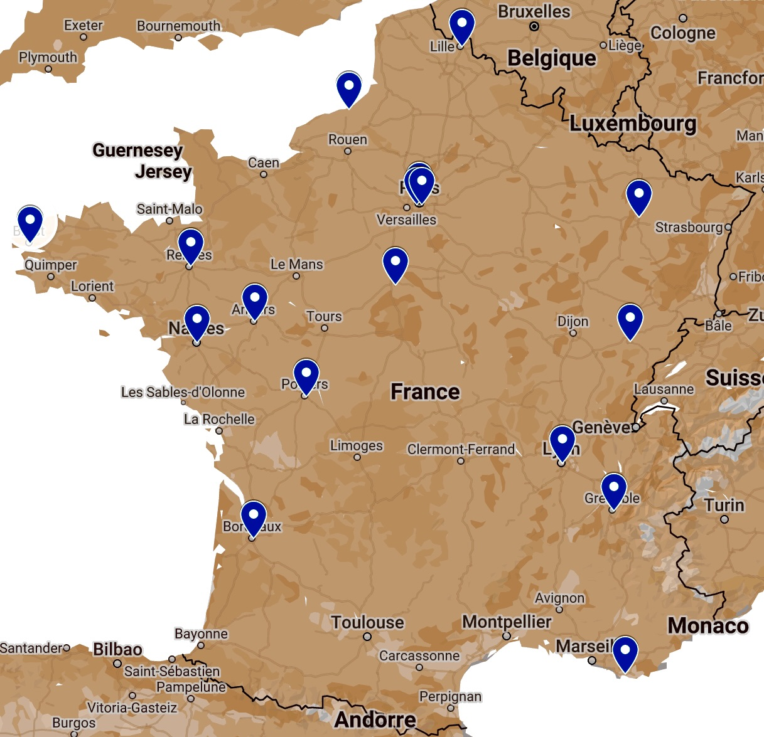
BIPASS Study
NCT04915014
1 m
1.5 m
Notes:
THE BIPASS STUDY is a multicenter prospective, randomized, controlled, open-label clinical trial testing the superiority of SG+TB over standard RYGB for patients operated on as a first-intention procedure for patient with morbid obesity (BMI≥40 kg/m² or BMI≥35 kg/m² associated with one co-morbidity which will be improved by surgery) or as a revisional procedure for patients with an insufficient weight loss or a weight regain superior to 20 % after SG.
Hypothesis:
Because there is no duodenal and jejunal exclusion, malnutrition is expected to be less frequent after SG+TB compared to BPD-DS. Its anastomosis on the antrum makes SG+TB easier to perform, notably in super-obese patients than standard RYGB, and it is more efficient in terms of weight loss and comorbidities remissions. Compared to BPD-DS or SADI-S, which involves a dissection of the duodenum and the confection of a duodenojejunostomy, SG+TB is also expected to be easier as well as safer (Table 1).

Slide 12
Assessment of eligibility (V1, day −120 to day 0)
Information, period of reflection, written informed consent
Randomisation 1:1
Minimisation on centre and on first-intention vs revisional surgery
Experimental arm (n = 160)
SG with transit bipartition
(V2, day 0)
Control arm (n = 160)
Roux-en-Y gastric bypass
(V2, day 0)
Follow-up visits V3 to V8: 1, 3, 6, 12, 18 and 24 months
Weight and BMI · nutritional and metabolic blood panel · impedance and grip strength
24-hour steatorrhoea (6 months) · endoscopy (12 months) · GIQLI, SF-36, Sigstad, LFPQ, IPAQ
Complications (Dindo-Clavien), readmissions, adverse events
Primary endpoint at 24 months %EWL,
standardised and assessed under blind conditions
Analysis in intention to treat, in all randomised patients
Linear mixed model with centre as random effect, multiple imputation of missing primary outcome data

Slide 13
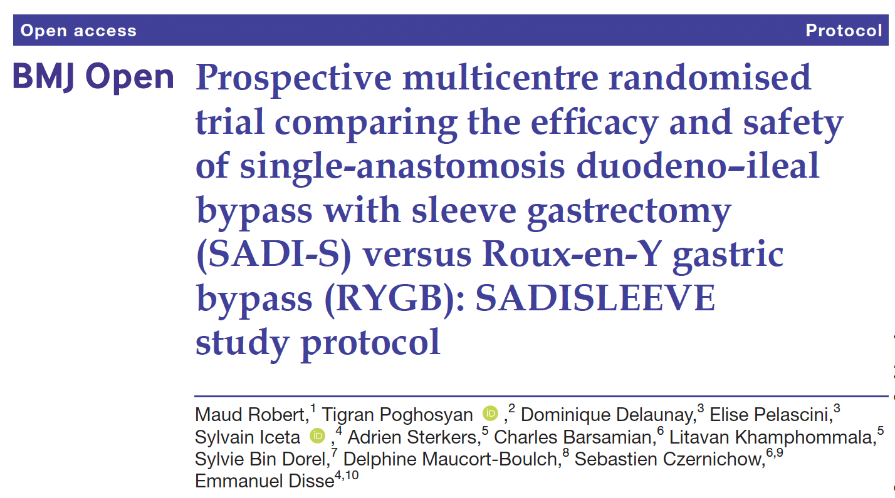
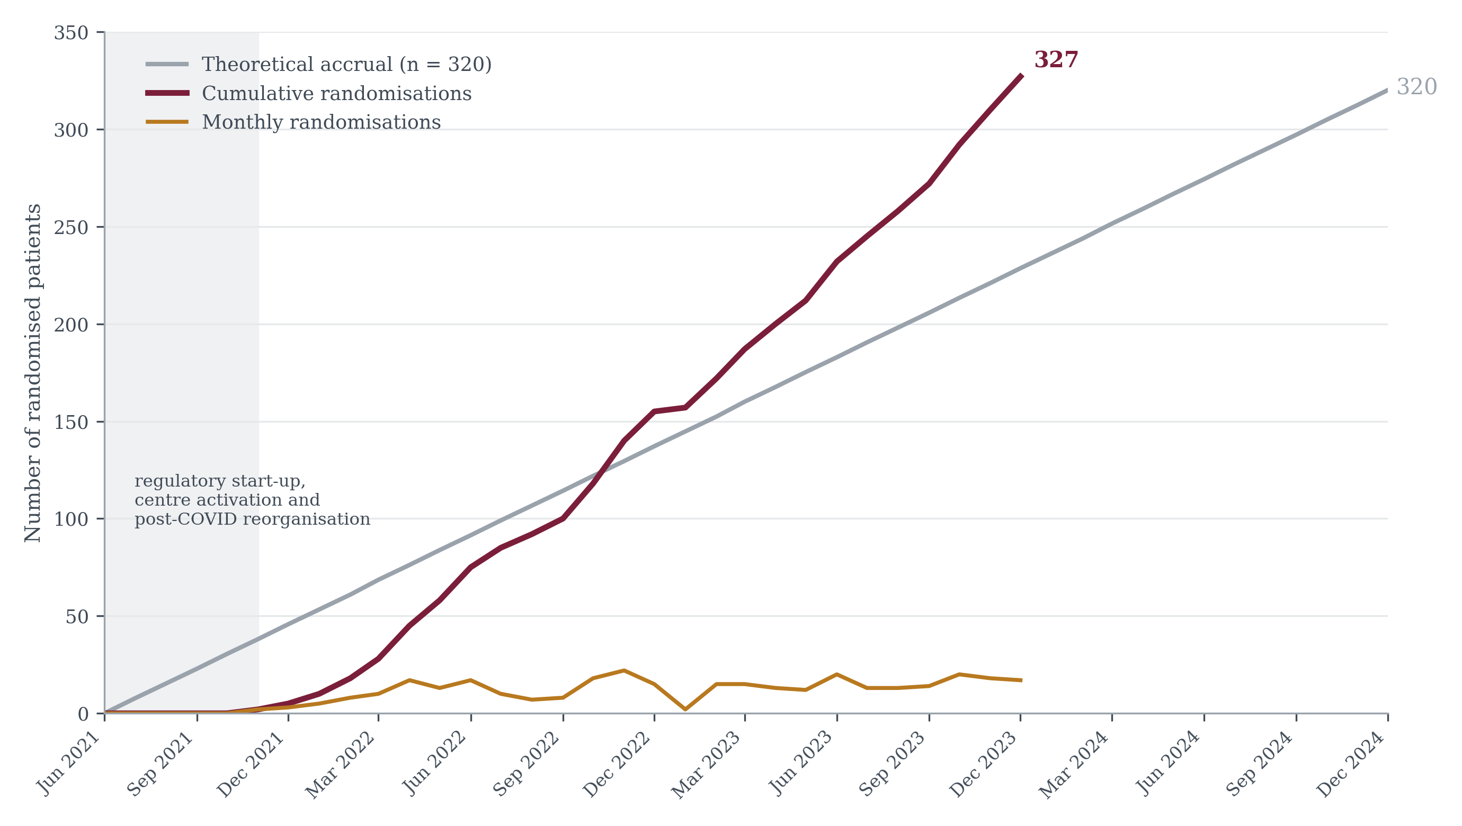
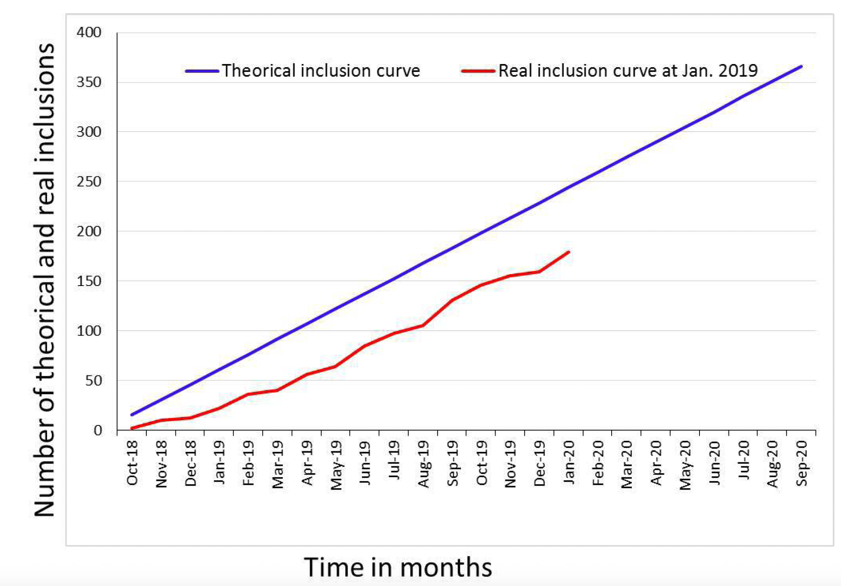
BIPASS Study

Slide 14




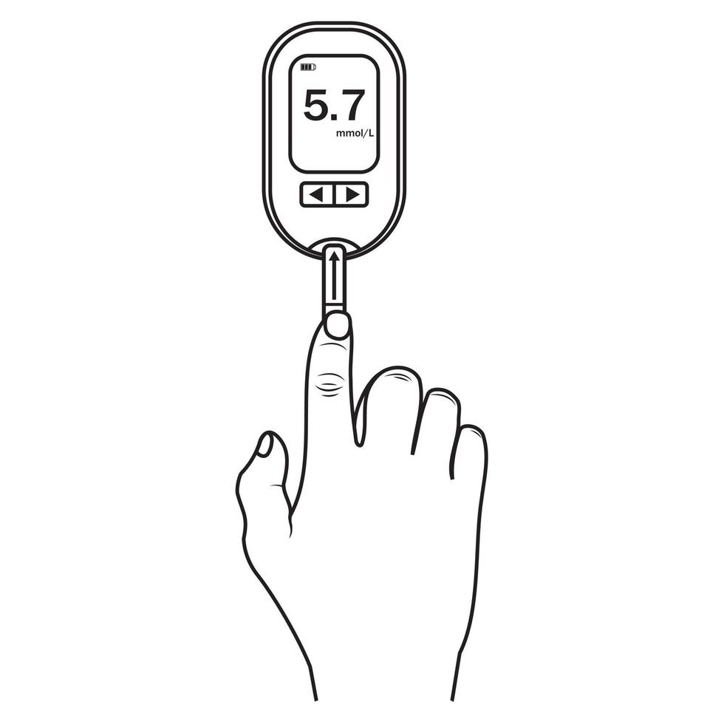

BIPASS Study
Like many prospective studies evaluating a new technique, the BIPASS trial has an independent safety monitoring committee that convenes after the first 10 inclusions and then after every 100 inclusions.
Complications
Dindo-Clavien
Follow-up
TWL%
I
II
Promoteur
HBA1c%
III
IV
V

Slide 15
BIPASS Study
Gastric bypass en Y (RYBG)
Sleeve gastrectomie avec bipartition du transit (SG+TB)
SAE
n= 11 (3,4%)
p= 0,54
Notes:
Schema a annoter avec les complications

Slide 16
BIPASS Study
Re intervention
RYGB | SG+BT
Stenosis of the J-J Internal Hernia X2 Leakage of the Excluded Stomach Anterior Wall repair | Stenosis of the I-I Twist of the I-I Fistula of the I-I Abdominal Wall Hematoma

Slide 17
BIPASS Study
Complications
n= 113 (34%)
p= 0,66
Ulcers
1,8%
8%
Diarrhea
Nutritional
7,3%
RYGB (n=163)
12,9%
SG+TB (n=164)
2,5%
GERD
n
Notes:
Denutriution
SG + BT : une patiente avec un contexte de diarrhées denutrition severe avec OMI et necessité de mettre en place une sonde naso jej

Slide 18
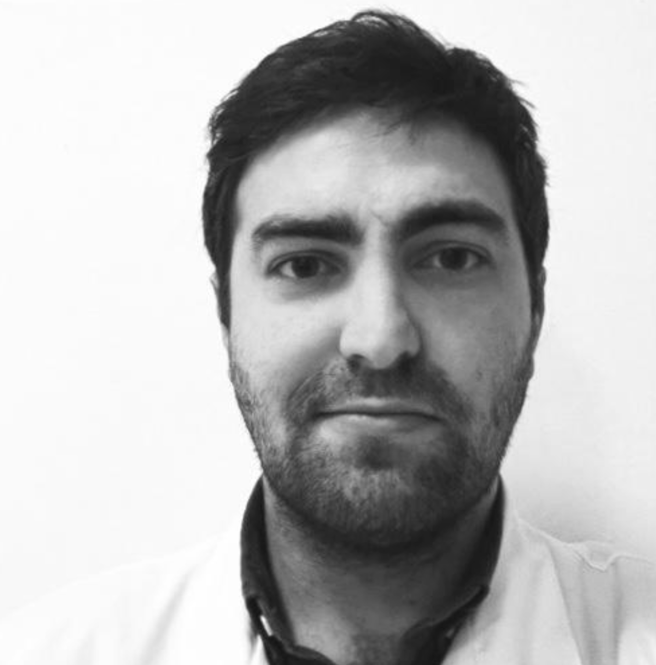
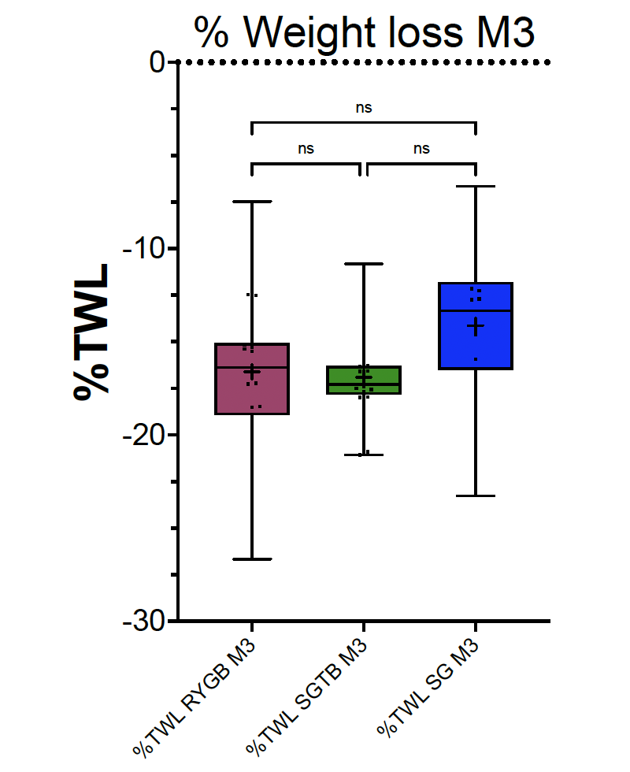
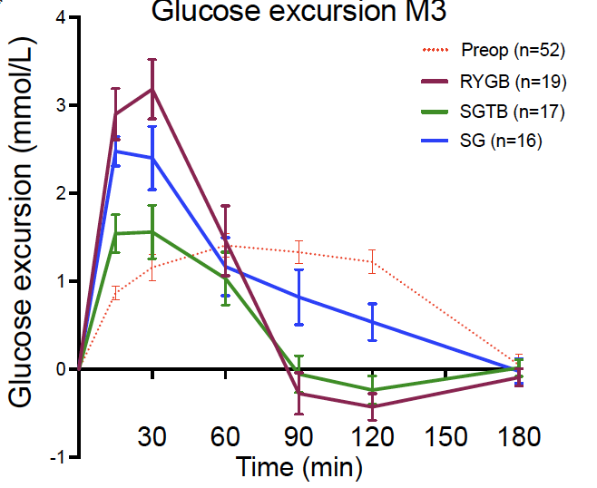
Physiological Outcomes
C Baratte, T Poghosyan, M Legal, F Pattou, R Caiazzo

Slide 19
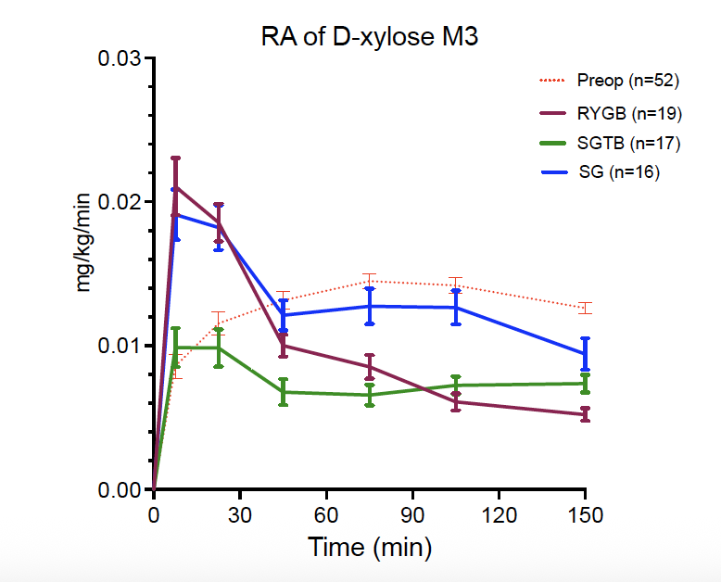
Physiological Outcomes
DUODENAL ABSORPTION
Nutrient | Note
Iron (Fe2+) | Principal site
Calcium | Principal site
Folate (B9) | Proximal
Vit. A, D, E, K | Onset
Carbohydrates | Onset
Mg, Cu, Zn | Partial
C Baratte, T Poghosyan, M Legal, F Pattou, R Caiazzo

Slide 20
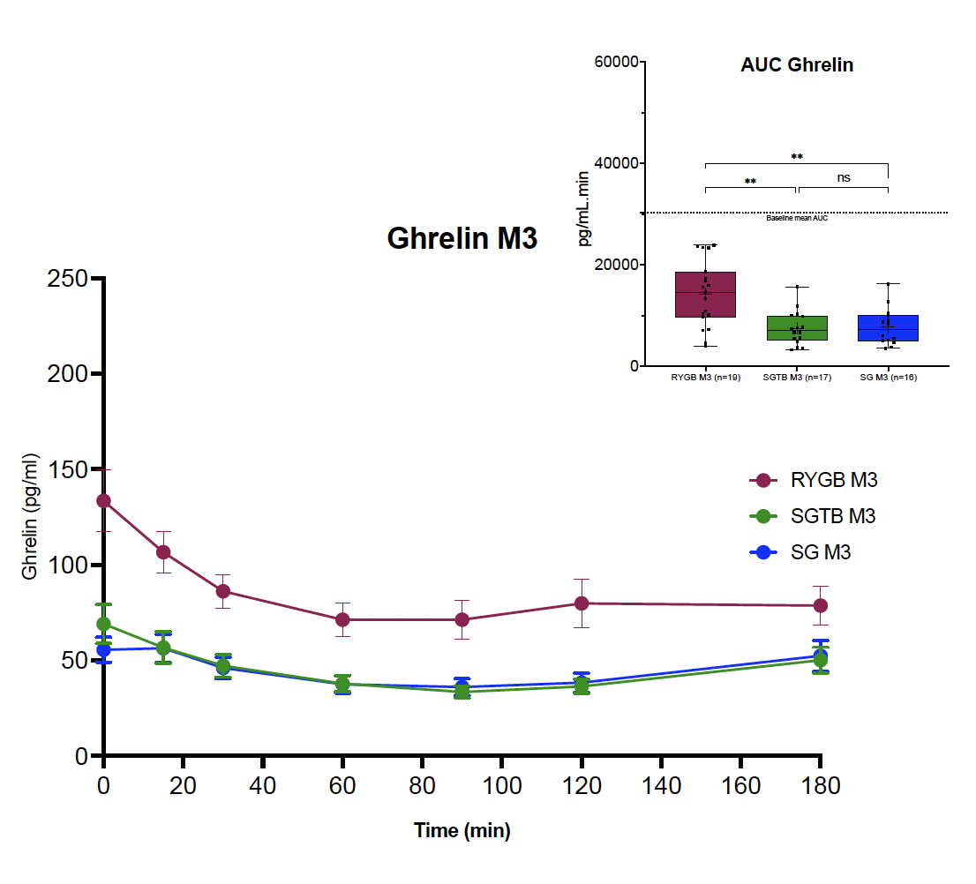
Physiological Outcomes
C Baratte, T Poghosyan, M Legal, F Pattou, R Caiazzo

Slide 21
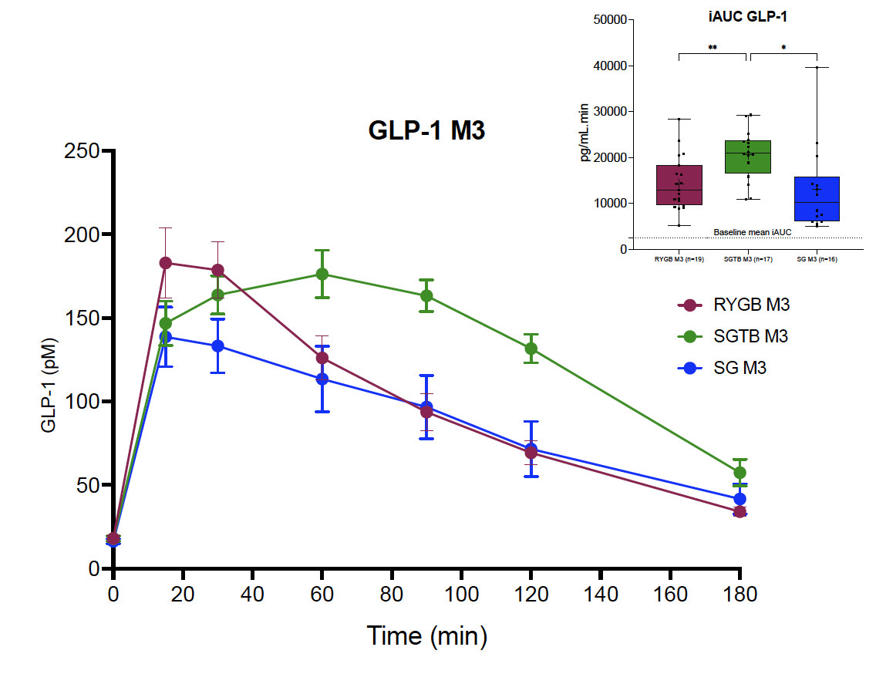
Physiological Outcomes
DUODENAL SECRETION
Cell | Hormone | Main effects
S | Secretin | Bicarbonate (pancreas, bile) ; restrains gastric acidity
I | CCK | Gallbladder emptying, pancreatic enzymes, satiety
K | GIP | Incretin: glucose-dependent insulin secretion
M | Motilin | Migrating motor complex (housekeeping motility)
L | GLP-1, PYY | Incretin, satiety (predominantly distal)
D | Somatostatin | Tonic restraint of endocrine secretions
C Baratte, T Poghosyan, M Legal, F Pattou, R Caiazzo

Slide 22

Transit Bipartition vs RYGBP : a true alternative
Prof. Robert Caiazzo, MD, PhD
CHU de Lille
Endocrine Surgery, Hepatology, Pathology, and Nutrition, CHU Lille
UMR Inserm 1190 Translational Research in Diabetes, Lille University
Labex EGID (European Genomic Institute for Diabetes) F Pattou
robert.caiazzo@univ-lille.fr

Slide 23


